Slide 1
CARLTON HOUSE TREATMENT & DRUG REHABILITATION CENTRE (CHTDRC)
Four Point Presentation
Background
Current Situation
Conclusion
Recommendations
Four Point Presentation
Background
Current Situation
Conclusion
Recommendations

Slide 2
Background
The popularly known Carlton House was a wooden & concrete Victorian design plantation building located at Parade, St. Paul’s, approx (2) miles outside of St. George..
The decision to initiate the Centre was as a result of the partial destruction of the Richmond Hill Mental Hospital 1983.

Slide 3
As a result the capacity for in-house patients was limited and a comprehensive reassessment of patients at the institution then had to be undertaken.
In January of 1985 it was established as the Carlton House Treatment and Drug Rehabilitation Centre (CHTDRC).

Slide 4
Aim:
The Centre was initially setup to provide treatment and rehabilitative care for persons identified with alcoholism and later other drug related problems.
A comprehensive reassessment of patients at the institution then had to be undertaken.

Slide 5
Patients assessment at the time was spearheaded by Dr. Michael Beauburn, Psychiatrist and Professor of Psychiatry at (UWI).
One of the findings of the reassessment was a large number of patients with alcohol related problems.
The establishment of a facility for the treatment of alcohol addiction was recommended.

Slide 6
Funding for the establishment of the institution was secured from;
The Smithers Foundation, USAID National Commercial Bank, and Jonas Browne and Hubbard’s
(Adapted from: Drug Control Secretariat-2005)
At the time of commissioning, Carlton House was designed to accommodate (16) patients, including (4) females.

Slide 7
The Center was constituted as a subsidiary of the Richmond Hill Institutions and was fully financed through budgetary allocation by the Ministry of Health

Slide 8
A cadre of (13) members of staff inclusive of (1) Ward Sister, (1) Staff nurse, (8) Nursing assistants, (2) Maid/Helpers and (1) cook manned the facility on a daily basis.
They were complimented by a visiting Psychiatrist, Psychologist, Occupational Therapist and Social Workers.

Slide 9
The main services offered at the Rehabilitation Centre were;
- Mild-detoxification - Individual therapy - Group therapy and - Family therapy
The centre also facilitated social integration through self help groups such as Alcohol Anonymous (AA) and Narcotic Anonymous (NA).

Slide 10
During its (20) years in operation an average of (1000) clients were admitted to the institution.
Statistics indicated that the period 1988 - 2004 there were (985) admissions comprising the following dependencies
- Alcohol (562)
- Marijuana (80)
- Cocaine/Crack (203)
- Poly drug use (140)

Slide 11
Statistics also indicated that there was a 12% percent, success rate among clients which surpassed the World Health Organization (WHO) established bench mark of 10% percent.

Slide 12
Subsequent the destruction of the facility by Hurricane Ivan drug rehabilitative services were then provided in an ad hoc manner.
This resulted in a gross deterioration of the organized system of the delivery of rehabilitative care based on the established curriculum.

Slide 13
Current Situation
In February 2008, a more organized system of delivering rehabilitative care was attempted with the acquisition of a rented facility at Belmont, St. George’s.
Three (3) members of staff;
(1) Ward Sister-who performs the role of Coordinator
(1) Nursing Assistant who performs the role of assistant coordinator
(1) Domestic Worker

Slide 14
Given the limitations at that facility only day care services are being provided.
These services include;
Responses to individual requests
(telephone calls & referrals)
Individual therapy
Family therapy

Slide 15
A total of twenty two (22) clients accessed the services offered at Belmont facility during the first year.

Slide 16
Consequently the following are being experienced;
An increase in the number of admissions at the Acute Centre – Rathdune
Lack of a structured delivery of the curriculum
Increase incidents of disturbances in family life
Increase incidents of job lost
Increase frustration on the part of Staff
Inadequate follow-up and treatment of discharged clients.

Slide 17
Conclusion
There is undoubtedly an urgent need for the provision of an adequate treatment and rehabilitation centre and a concerted effort should be made for its construction.

Slide 18
Recommendations
The facility should be constructed in an accessible location
The facility should be adequate for both male and female clients
The facility should be able to accommodate residential care
The facility should be able to provide the appropriate rehabilitative services

Slide 19
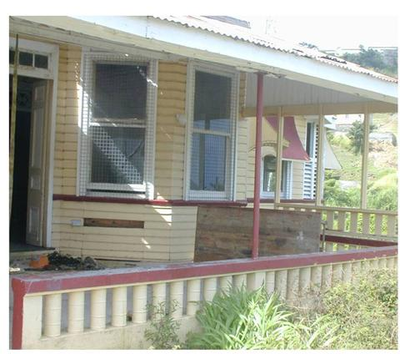
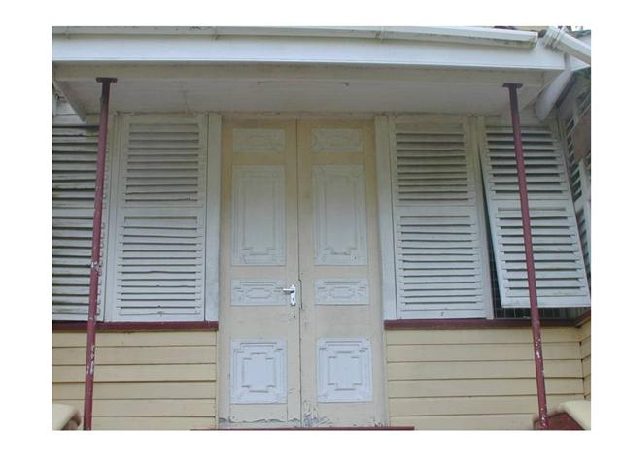
Thankyou for your time

